Slide 1
Social Media
Vs.
Artificial Intelligence

Slide 2
CONCEPT OVERVIEW
This project intends to examine whether the development history of social media and artificial intelligence are aligned with check-out book records in the Seattle library. Both social media and artificial intelligence are emerging technologies that have become known to the public and led to some heated discussions.
By visualizing these two concept-related books' check-out records together within a 3D model, we can gain insights into how the public gets to learn about new technologies through borrowing book from the library (time, date, itemNumber).

Slide 3
DATA DESCRIPTION
Size & Features & Transformation

Slide 4
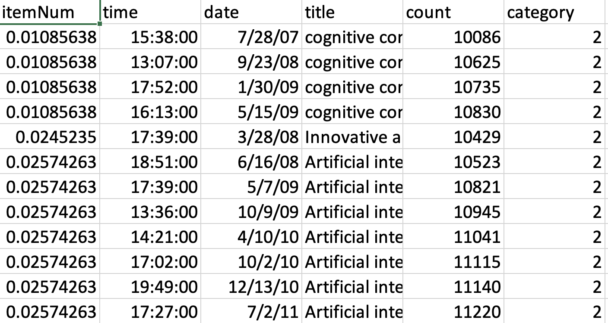
1.

Slide 5
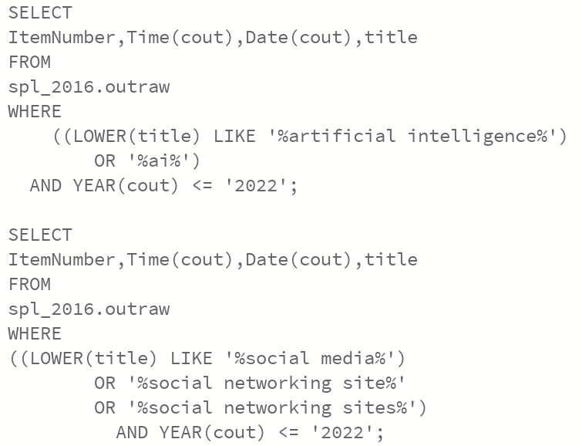
Main Features
Rows = 14670
Three dimension:
  ItemNumber (transformed)
  Time (10 AM-8 PM)
  Date (2006-2022)
Count: the number of record
Category:
  1-social media
  2-AI

Slide 6
Problems & Potential Improvement
float timeAxis = map(timeParser(books.get(i).time), 600, 1200, -50, 50);
float itemAxis = map(books.get(i).itemNum, 0, 1.01, -50, 50);
Outliners in the time dimension don’t get adjusted (out of the box)
ItemNumber = original/8,000,000 [86851, 8018820]
*One item can be borrowed multiple times
Better visualization effect (color, shape, newfunction):
show title when the mouse get close

Slide 7
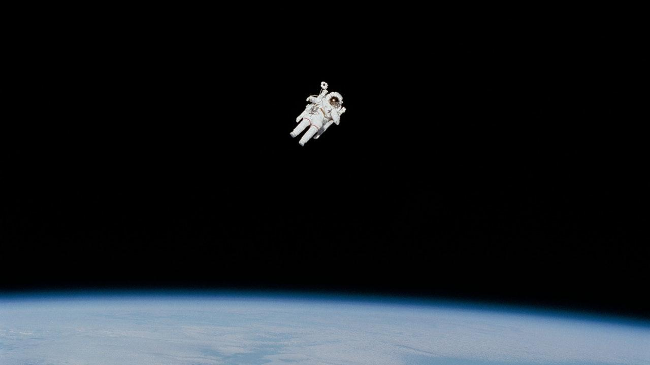
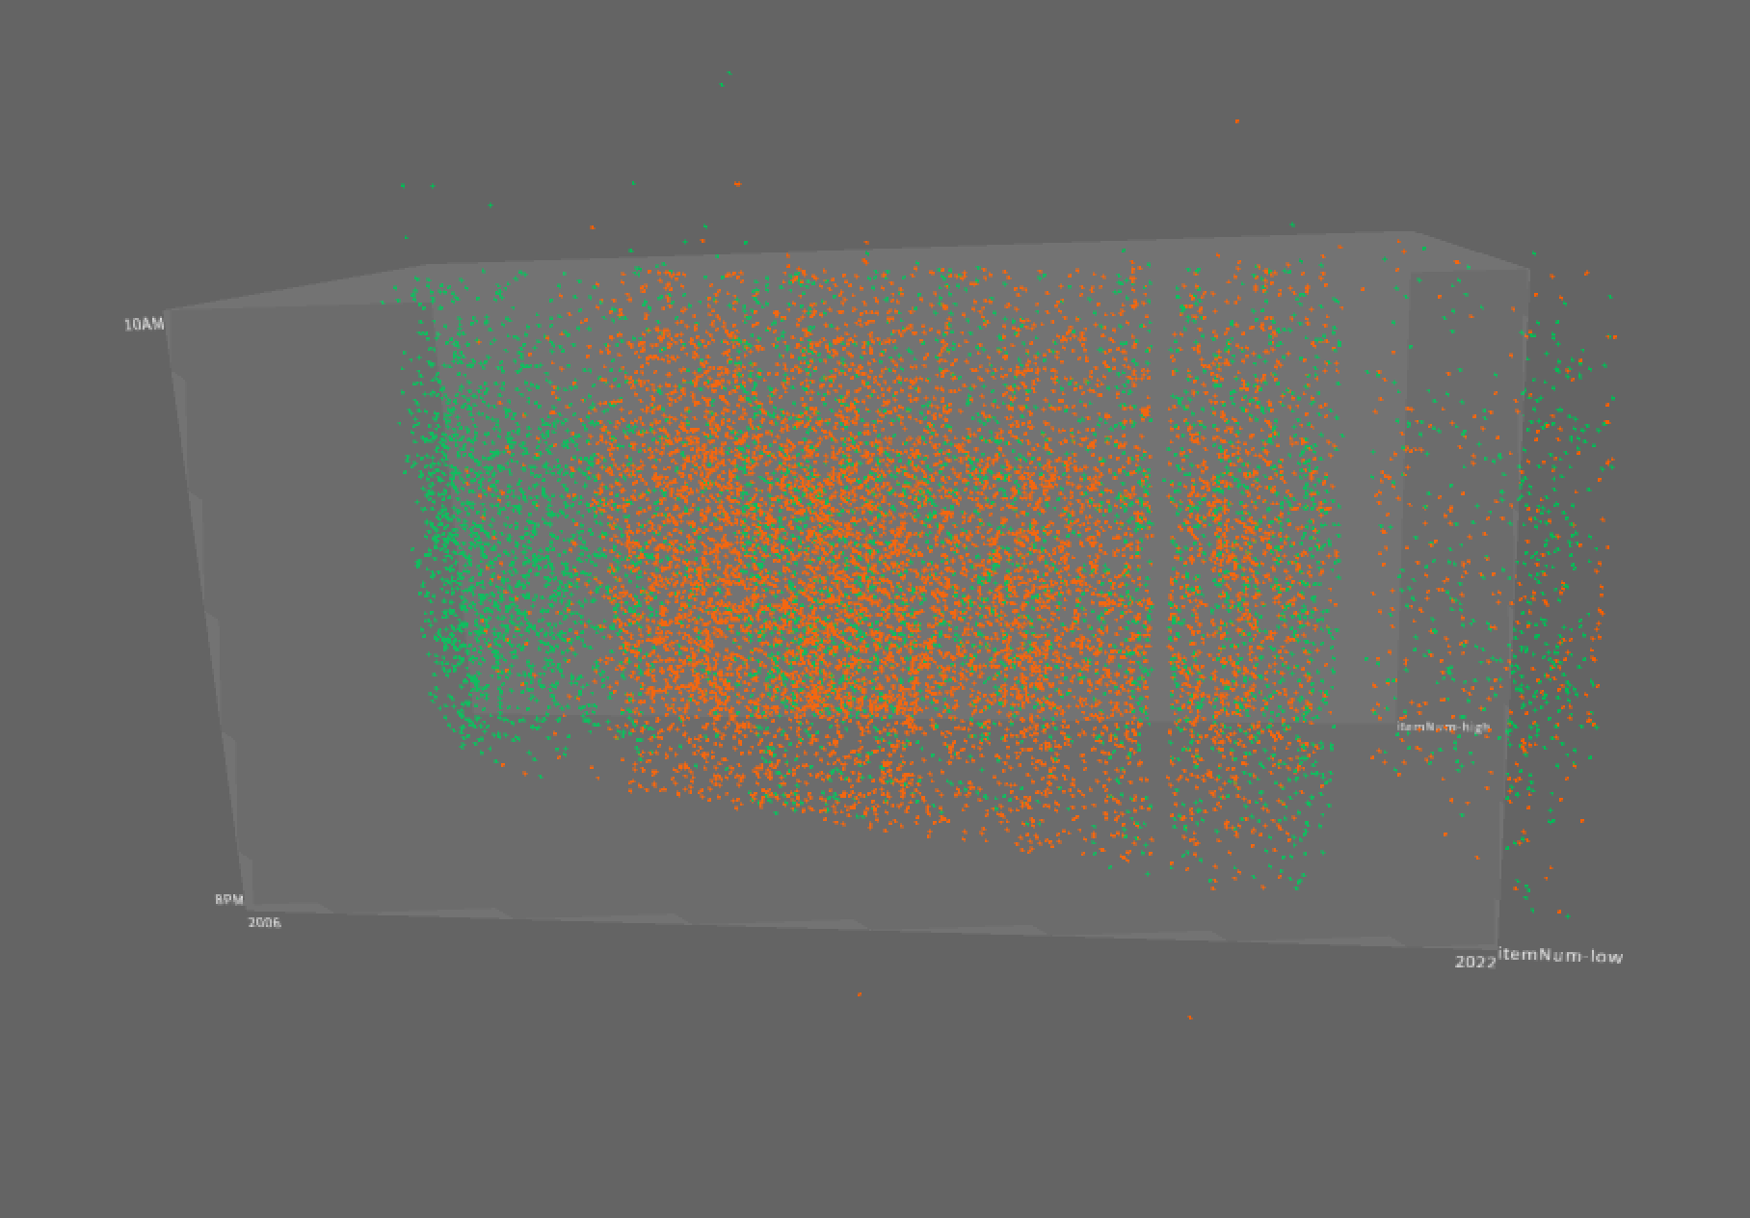

Slide 8
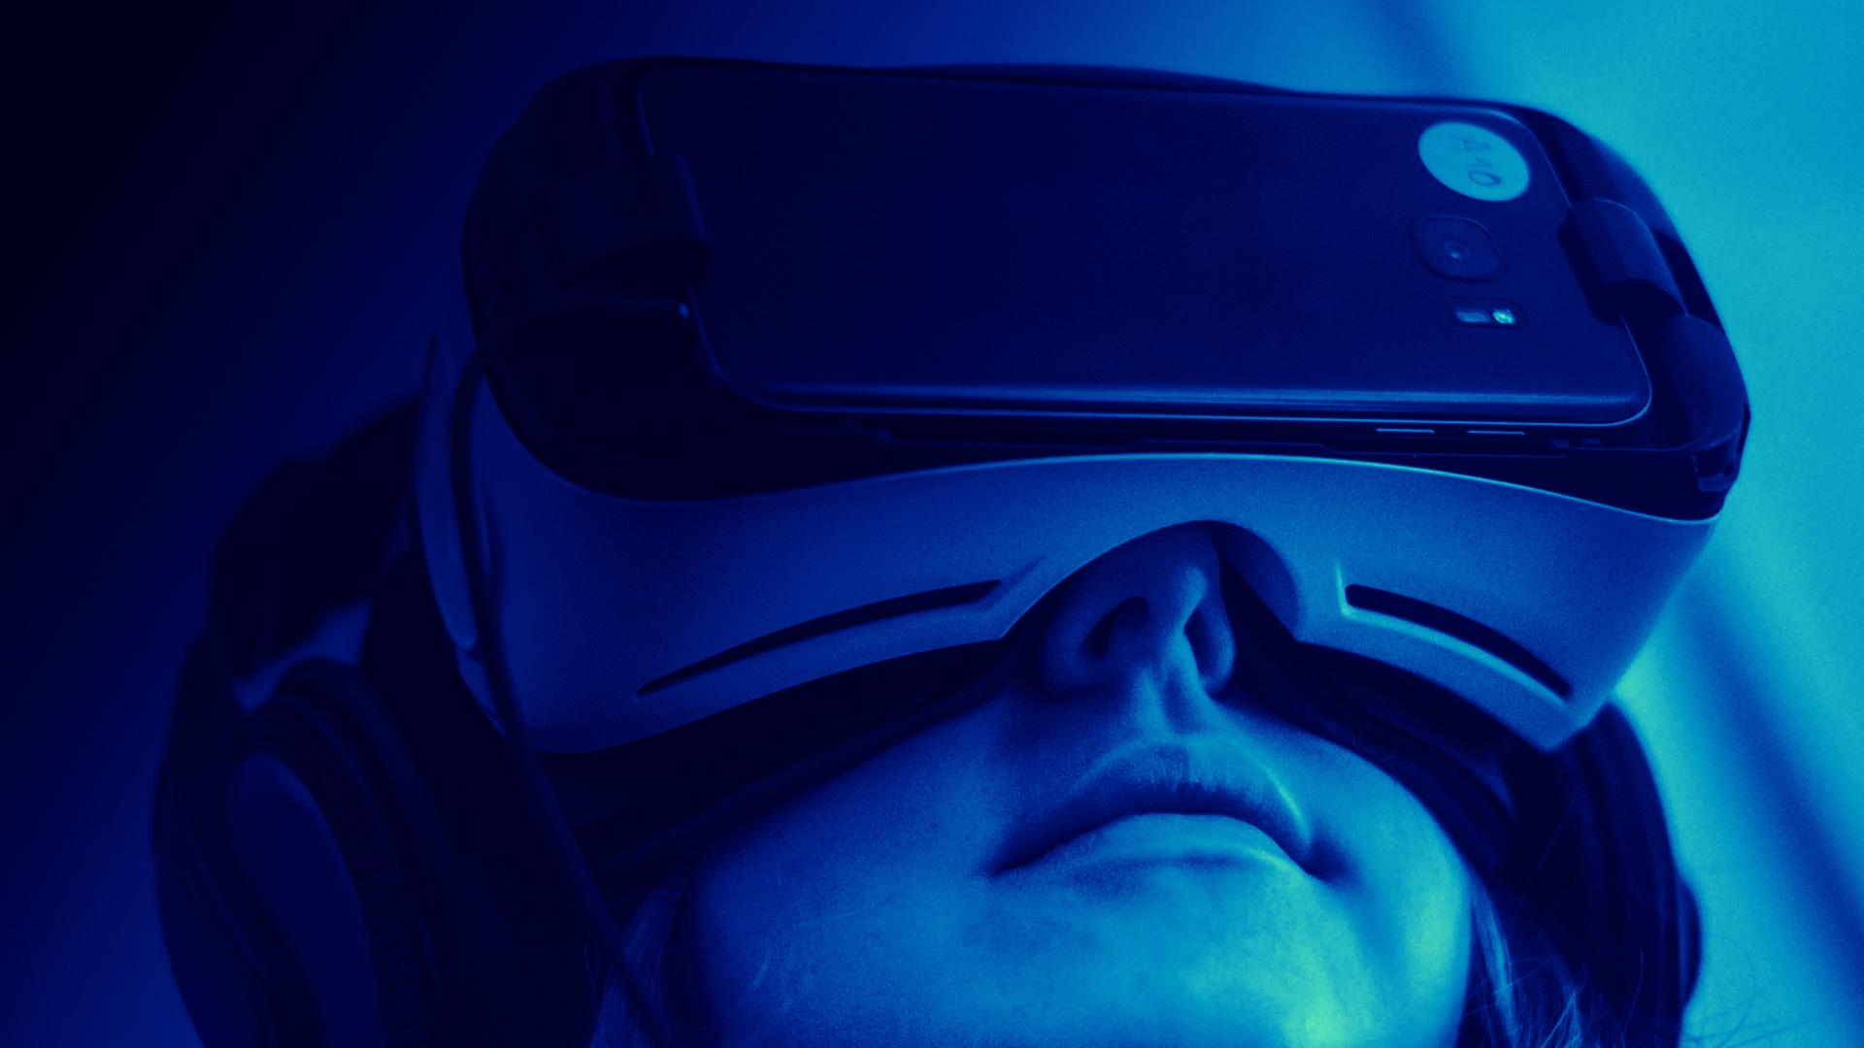
Question?
qinghuang@ucsb.edu

