Slide 1



MAT-259
Social Media
Vs.
Artificial Intelligence

Slide 2

Basic Structure
Category: Red-social media
Green-AI
Toggle (Boolean control)
X: Time (10 AM-8 PM)
Y: Date (2006-2022)
Z: Item Number (NEW-OLD)
Line with changing color
Press Space to show the box
Button Controls from Yanchen

Slide 3


  INTERACTIONS
01
02
03
04
05
A mouse left-drag: rotate the camera around the subject
A double-click restores the camera to its original position.
Mouse Near Point: Show Book Title
Press SHIFT: Show Check-out Date Instead
Press CONTROL: Show ItemNumber Instead

Slide 4


Keyboard Control
keyPressed
KeyReleased
ROTATION

Slide 5


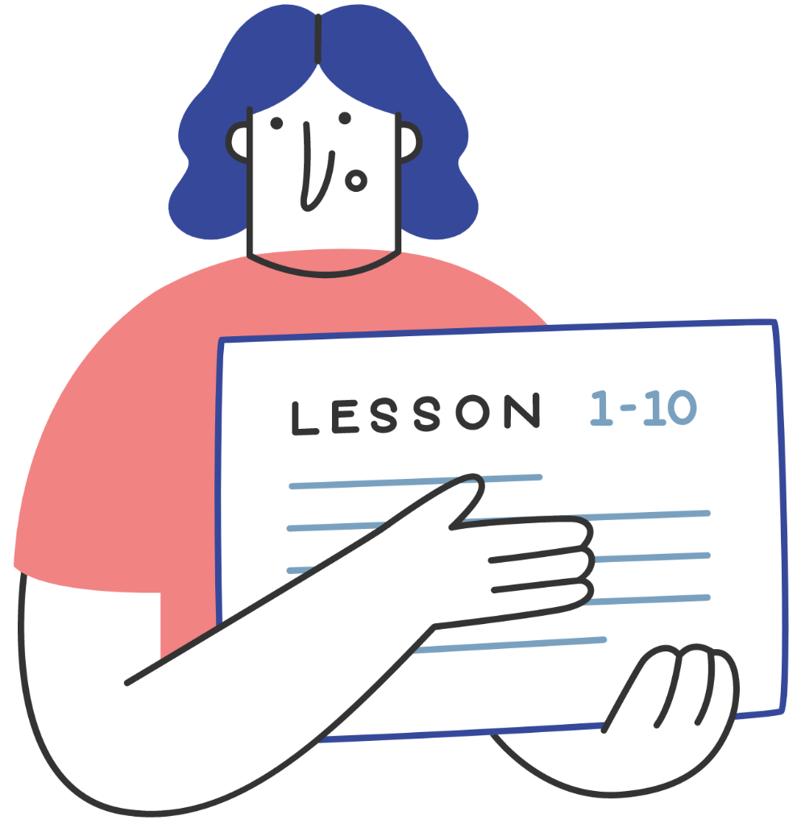
Fun Exploration for patterns

Slide 6

Thank you!
Write a closing statement or call-to-action here.

